Slide 1
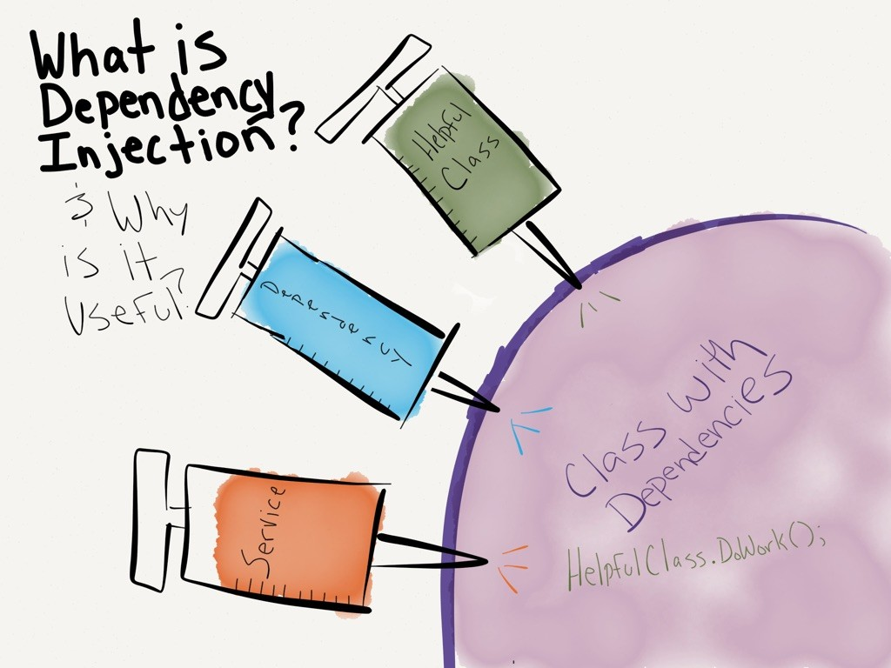
C♯ Dependency Injection Testing Entity Framework
Rasmus Lystrøm
Associate Professor
ITU

Slide 2

Agenda
Clean Onions
Repository pattern
Testing database code
Dependency Injection
Testing Entity Framework
This Photo by Unknown Author is licensed under CC BY-NC-ND

Slide 3

Onion Architecture

Slide 4
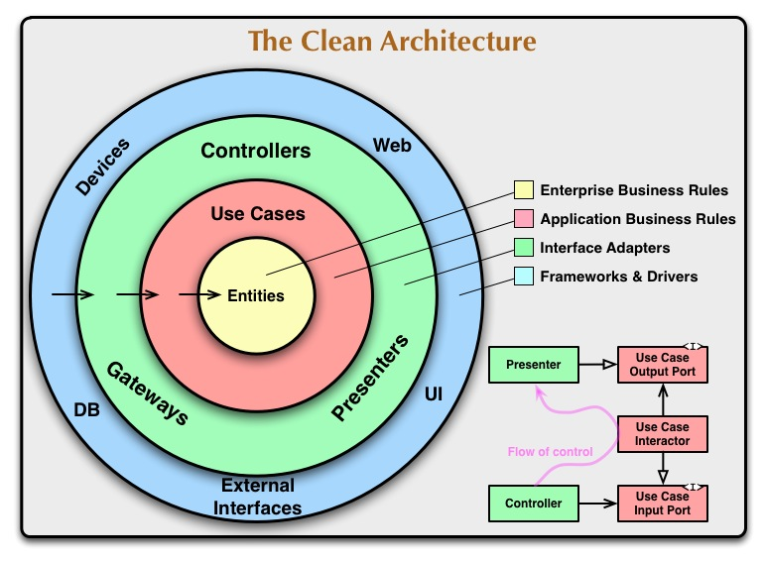

Slide 5

The Repository Pattern
This Photo by Unknown Author is licensed under CC BY-SA

Slide 6
The Repository Pattern
Enable CRUD on domain objects (entities)
Usually: one repository per entity
Debatable: has a Save() method

Slide 7
Generic Repository
public interface Repository<T, K>
{
T Create(T entity);
IReadOnlyCollection<T> Read();
T Read(K id);
void Update(T entity);
void Delete(K id);
}

Slide 8
The Repository Pattern
… but wait … Entity Framework already does not for me!?

Slide 9
Recommended Repository: Per entity e.g., Character
public interface ICharacterRepository : IDisposable
{
int Create(CharacterDetailsDTO character);
CharacterDetailsDTO Read(int characterId);
IReadOnlyCollection<CharacterDTO> Read();
void Update(CharacterDetailsDTO character);
void Delete(int characterId);
}
…or something similar…

Slide 10
Testing …
Testing live databases is hard
Testing live full systems is hard
By transitivity: Testing … is hard…

Slide 11
http://dwiardiirawan.com/index.php/2016/05/18/what-is-dependency-injection-and-what-are-the-advantage/

Slide 12
Dependency Injection
Software design pattern which implements Inversion of Control (IoC)

Slide 13
Dependency Injection (DI)
Constructor Injection
Property (Setter) Injection
Interface Injection

Slide 14

Dependency Injection
Structured readable code
Testable code
Dependency Inversion Principle
Separation of Concerns
Rock SOLID!!!
AWESOME!!
Pun intended

Slide 15
Programming to interface, not implementation…
public interface IFooService
{
bool Bar(Foo foo);
}
public class FooService : IFooService
{
bool Bar(Foo foo)
{
// Implementation
}
}
public interface IFooMapper
{
Foo Map(Qux qux);
}

Slide 16

Using IFooService ?
public class Baz
{
public bool Grault(Qux qux)
{
IFooMapper mapper = new FooMapper();
var foo = mapper.Map(qux);
IFooService service = new FooService();
return service.Bar(foo);
}
}

Slide 17
Constructor Injection (preferred)
public class Baz
{
private readonly IFooMapper _mapper;
private readonly IFooService _service;
public Baz(IFooMapper mapper, IFooService service)
{
_mapper = mapper;
_service = service;
}
public bool Grault(Qux qux)
{
var foo = _mapper.Map(qux);
return _service.Bar(foo);
}
}
Private readonly fields
Initialize from constructor

Slide 18
Property Injection
Public setter
public class Baz
{
public IFooService Service { private get; set; }
public bool Grault(Qux qux)
{
...
return Service?.Update(foo);
}
}
Is this King?

Slide 19
Interface Injection
public interface IServiceSetter<T>
{
void SetService(T service);
}
public interface IServiceSetter<T>
{
T Service { set; }
}

Slide 20
Interface Injection II
Interface
public class Baz : IServiceSetter<IFooService>
{
private IFooService _service;
public void SetService(IFooService service)
{
_service = service;
}
public bool Grault(Qux qux)
{
// Implementation
}
}
Implement interface

Slide 21
Interface Injection III
Interface
public class Baz : IServiceSetter<IFooService>
{
public IFooService Service { private get; set; }
public bool Grault(Qux qux)
{
// Implementation
}
}
Implement interface

Slide 22
Best practices
Use
Use Adapter to enable interface if needed
Use
Use constructor injection
Program
Program to interface
Use
Use an IoC container
More on this in a couple of weeks...

Slide 23
Testing Entity Framework

Slide 24
SQLite in-memory database
dotnet add package Microsoft.EntityFrameworkCore.Sqlite
using var connection = new SqliteConnection("Filename=:memory:");
connection.Open();
var builder = new DbContextOptionsBuilder<MyContext>().UseSqlite(connection);
using var context = new MyContext(builder.Options);

Slide 25
Demo
Black box testing with SQLite in-memory

Slide 26
Best practices
Wrap in logical units/service classes/repositories
Don’t test built-in code…
Program to interface
Repositories should not depend on other repositories

Slide 27
Thank you

